Slide 1


Shri Sai Shikshan Santha’s
Nagpur Institute of Technology
Department of Computer Science and Engineering Even Session: 2021-2022
Project Name:-
“Online Lecture Management System”
Presented By- Mr. Shubham More Mr. Vishal Lamsoge Mr. Balwesh Puramkar
Miss. Gayatri Dhandare
Guided By- Prof. Shradha Raut

Slide 2

Presentation On Project Introduction

Slide 3
Contents
Introduction
Literature review
Problem statement
Proposed system
Methodology/Technology used
Hardware & Software requirements
Modules
Application
Conclusion
References
23-02-2022
Online Lecture Management

Slide 4
Introduction
Online Lectures Management System
For Faculties:
This Application Help to Deliver Daily Lectures to Students in an Easy Way.
Faculty can attach Soft copy along with a Lectures.
For Students:
Students Can Watch Lecture Any Time Anywhere.
For Departmental Head:
Central Management Architecture
H.O.D’s can directly manage and Control Faculties and students.

Slide 5
Literature review
Author Name
Paper Title
Publication
Technology used
Limitation
Oswald and Kay
XAMPP
2006
Apache MySql
no limitation
Any Internet browser
-
-
-
-
Jon Skinner
Sublime Text
2016
texting
no limitation

Slide 6
Problem Statements
In Whatsapp group teachers send the contents or notes got mixed & difficult to find
If any student miss their lecture then he/she can get lecture easily see the contents what he missed

Slide 7
Proposed System
Super Admin - H.O.D
Create Admin Users
Delete All Users
Create subject
Assign subject
Admin
HOD
Admin- Faculty
Add/Delete lectures
Add/Delete notes
Password change
Sign in
User
Faculty
User
Student
User - Student
Access lectures
Password change
Sign in
Sign up
Fig. 1

Slide 8
Admin
Admin Login Page
Super Admin Dashboard
Create/delete Teacher Account
Login out
Fig. 2

Slide 9
Teacher
Teacher Login Page
Teacher Dashboard
Create/Delete Subject
Add Lecture notes- Documents
Add Lecture notes- Documents
Add Lecture- video
Fig. 3

Slide 10
Students
Sign In/Sign Up
Student Dashboard
View Lecture
Download Notes
Update Profile
Log out
Fig. 4

Slide 11
Hardware and Software Required:
Languages:
Front End:
Servers:
Web servers:
Apache
Nginx Database Server:
MySql
AWS Aurora(Cloud)
HTML
CSS
jQuery
Bootstrap
Back End:
- PHP
- JavaScript

Slide 12
Modules
Login Screen:
For Faculty/ Student
Secure Login for Departmental Head
Dashboard screen:
For students:
Watch Lecture (View Access)
Download Notes (read Access)
For faculty:
Add/Update Lectures
Add/Update Notes(Read/Access)
Block student users

Slide 13
Modules
For H.O.D. :
Add/Delete Faculty users
Add/Delete Subjects
Assign subject to teachers
Block student users
Full control on Faculty/students users

Slide 14
Modules Snapshots

Slide 15
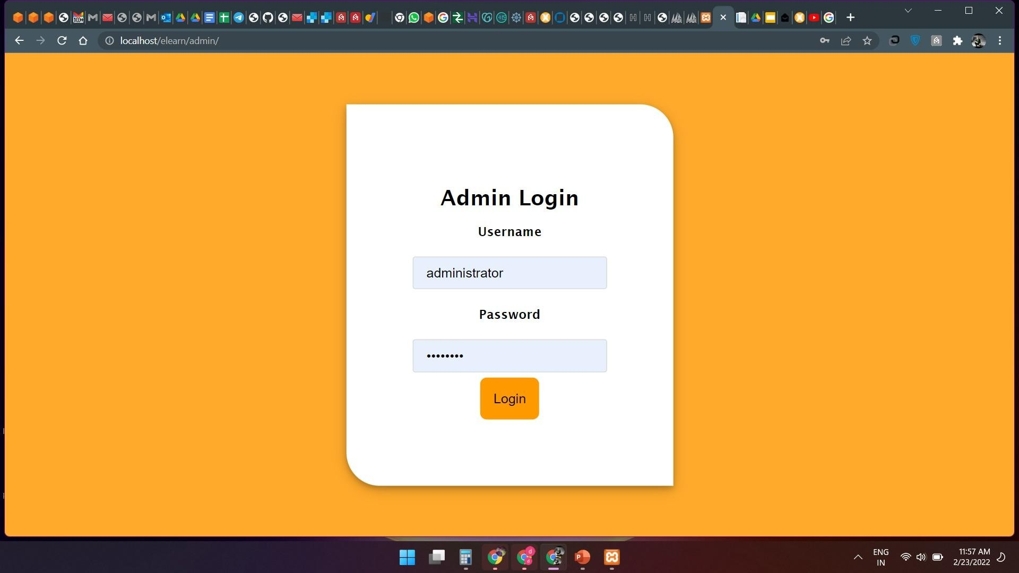

Slide 16
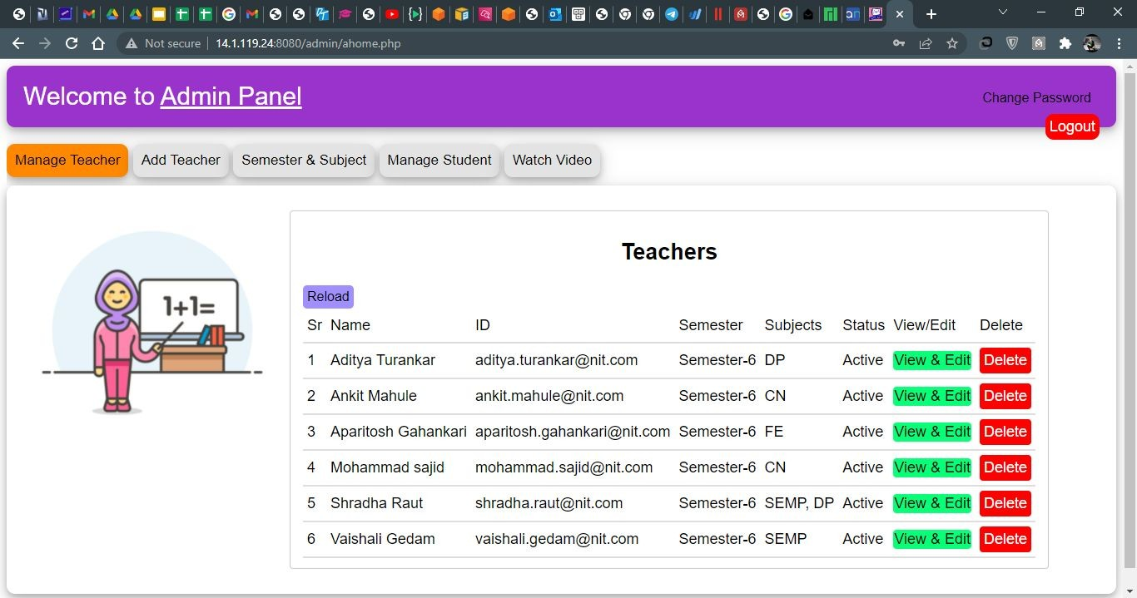

Slide 17
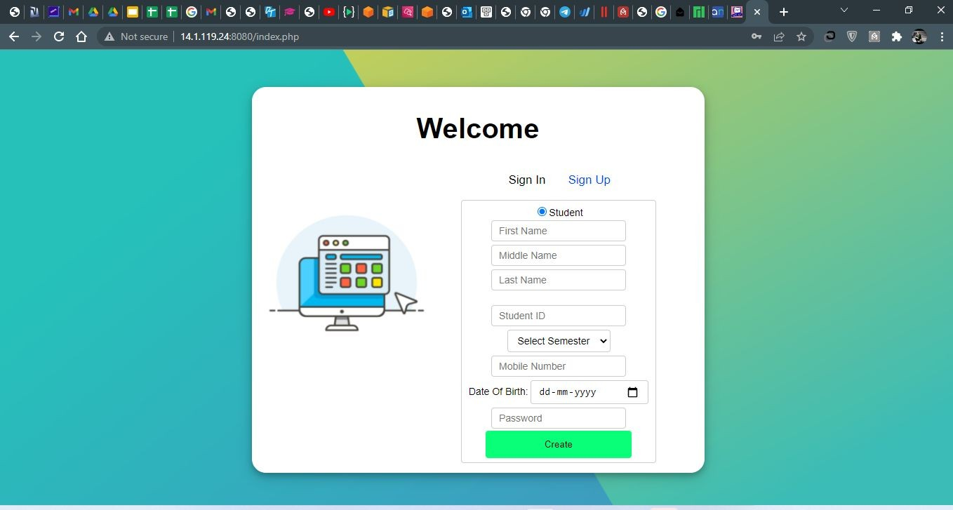

Slide 18
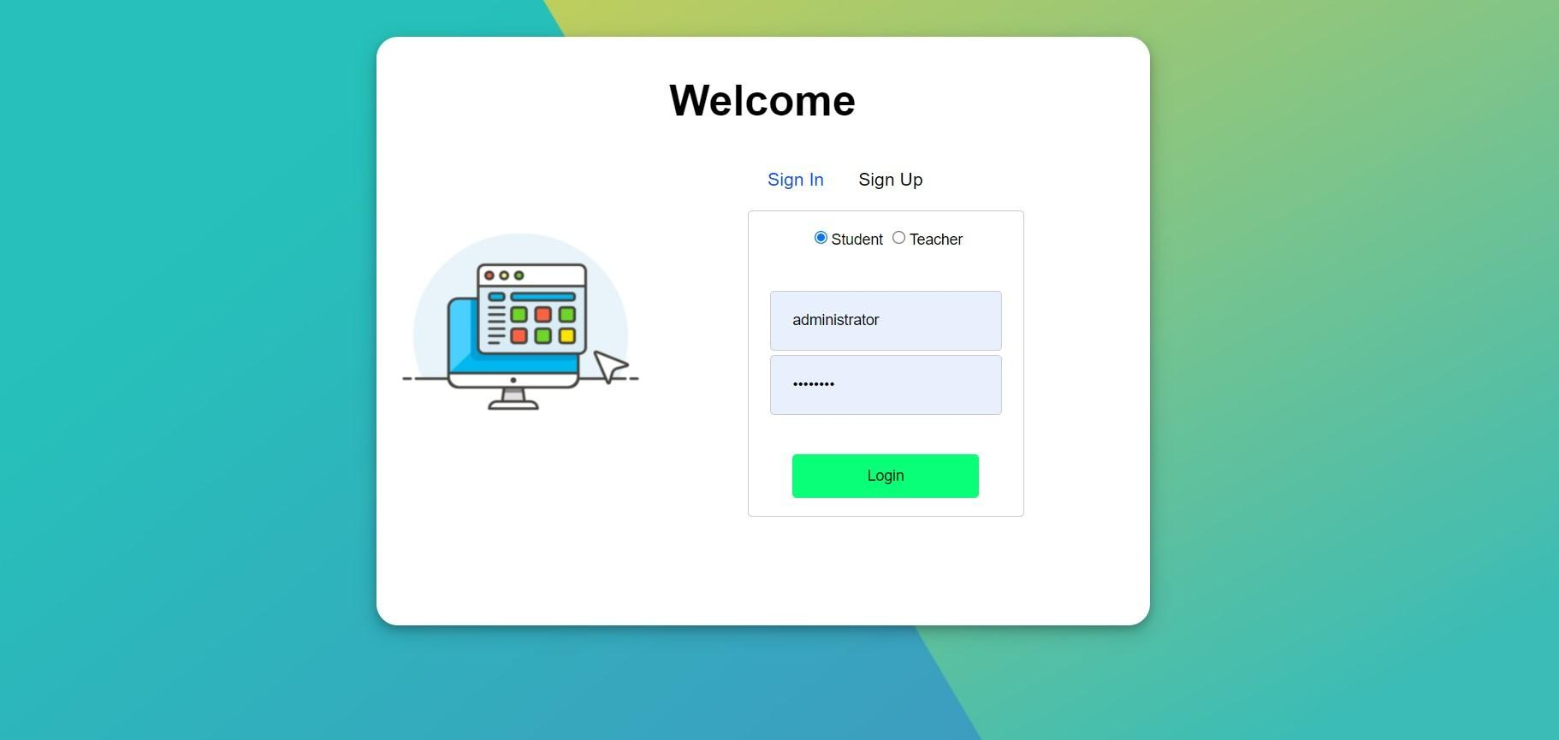

Slide 19
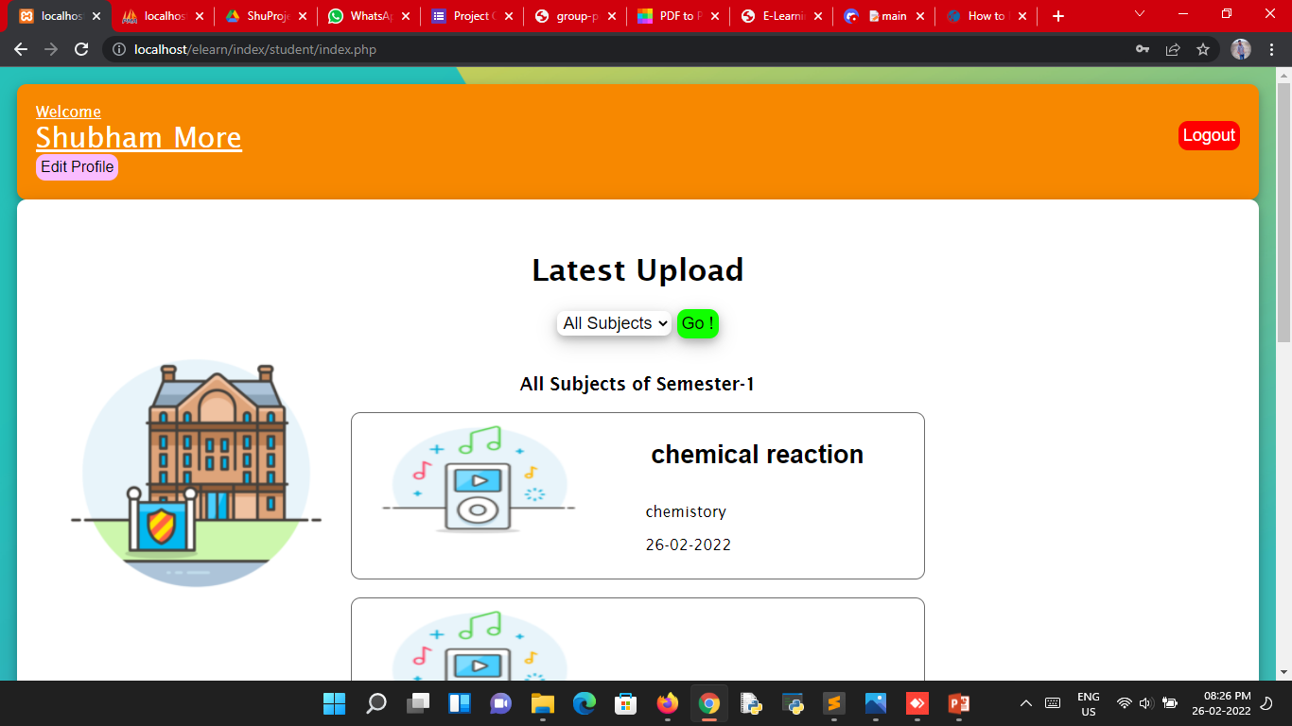

Slide 20
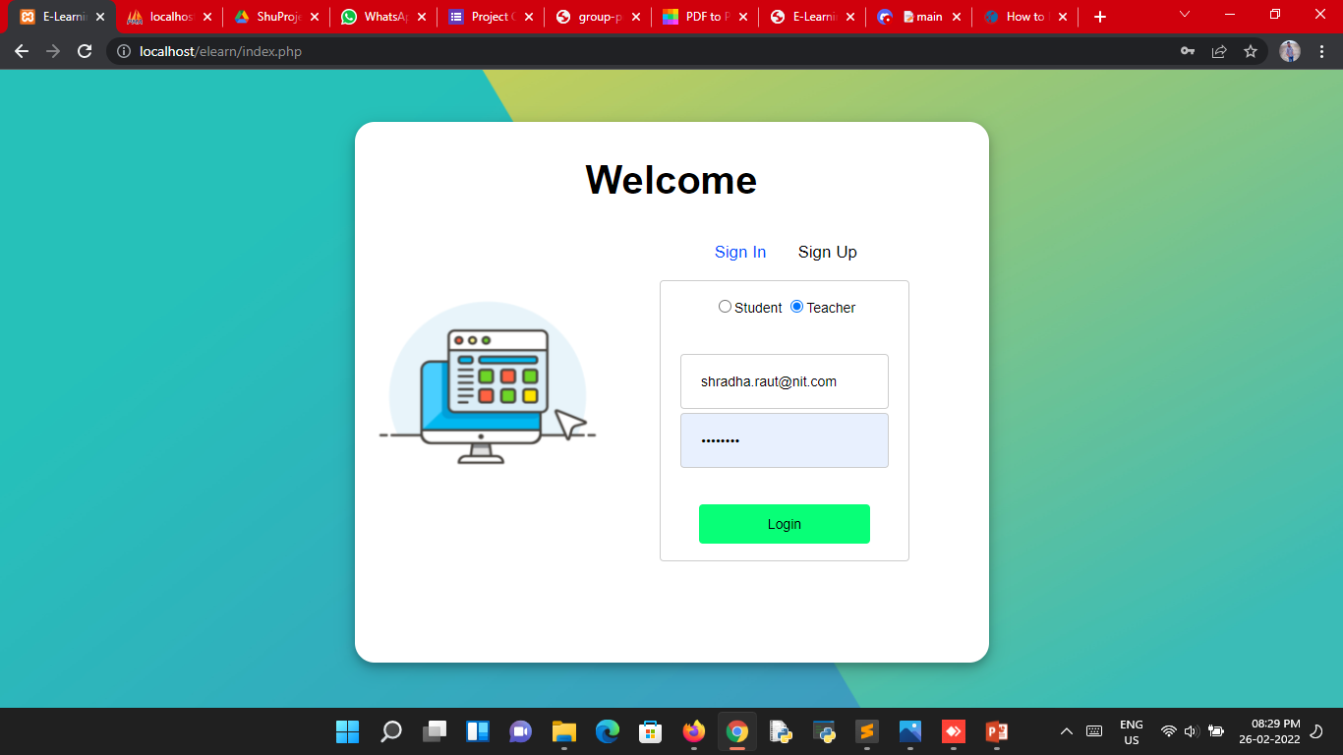

Slide 21
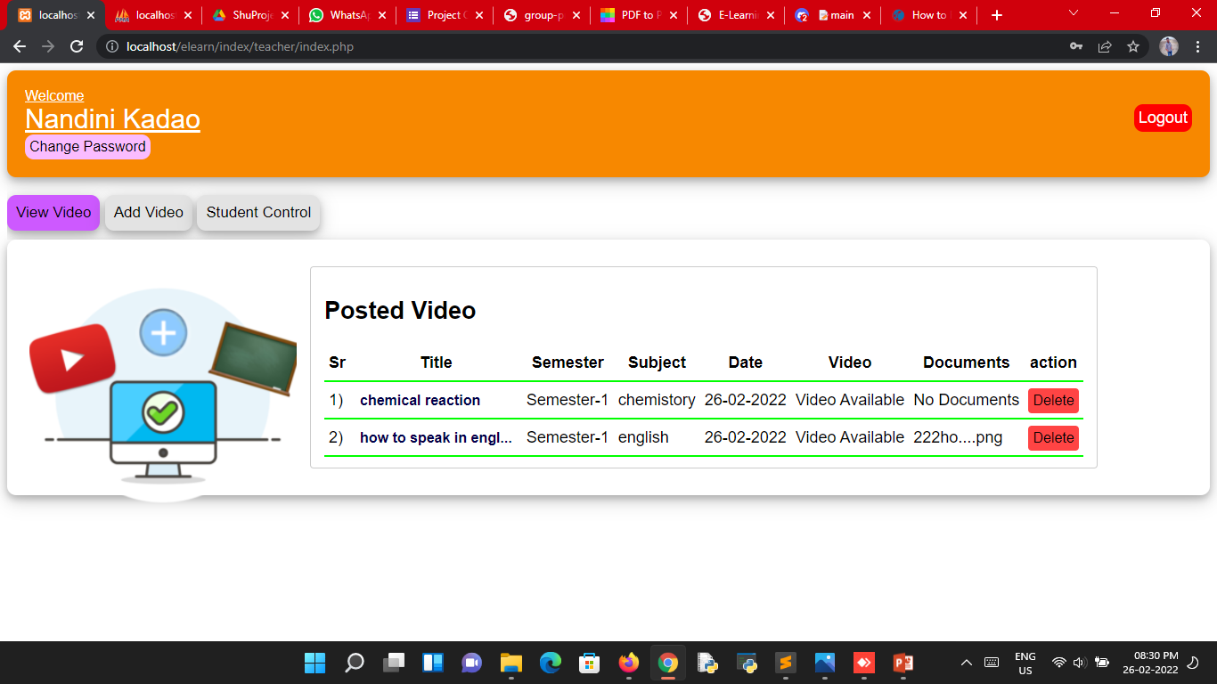

Slide 22
Application
Online Learning
Easy to provide notes
Can be accessible anytime

Slide 23
Conclusion
This project will help student to learn online.

Slide 24
References
https://byjus.com/
https://www.vedantu.com/
https://www.toppr.com/
https://unacademy.com/
https://www.nptel.com/
https://www.w3schools.com
https://www.javatpoint.com

Slide 25
Thank You

Slide 26
Questions?

